Slide 1
GLASS CLASSIFICATION
Name-Sahil Bhosale
PRN NO-22070243010

Slide 2
Attribute Information
RI: refractive index
Na: Sodium (unit measurement: weight percent in corresponding oxide, as are attributes 4-10)
Mg: Magnesium
Al: Aluminum
Si: Silicon
K: Potassium
Ca: Calcium
Ba: Barium
Fe: Iron
Type of glass: (class attribute)
1. building_windows_float_processed 2. building_windows_non_float_processed 3. vehicle_windows_float_processed 4. vehicle_windows_non_float_processed (none in this database) 5. containers 6. tableware 7. headlamps

Slide 3
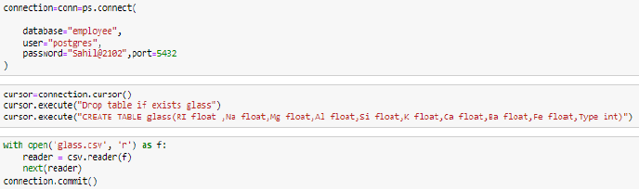
DATA CONNECTION
Importing the dataset is the most important feature of building a model. Dataset can be imported by using pandas by using the command read_csv. Loading the dataset is the most important part of building a model as you can perform various steps on the dataset and perform EDA on it.
Here the dataset is imported in the model using psycopg2 library. The connection has been created with the table and the queries has been passed to copy the data from the csv file.

Slide 4
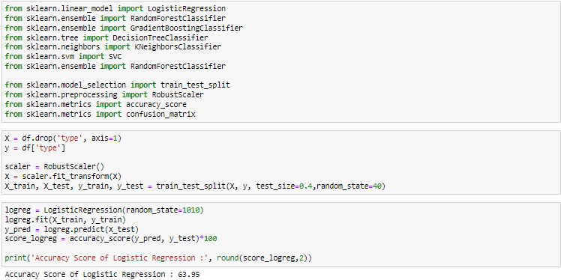
MODELS
LOGISTIC REGRESSION
To create a glass classifiers model based on logistic regression, we would start by gathering a dataset that contains features of different types of glass and their corresponding classifications.
Once the dataset is collected and prepared, we would split it into training and testing sets.
Overall, a glass classifiers model based on logistic regression can be a useful tool for predicting the type of glass based on its characteristics. However, the accuracy of the model will depend on the quality of the dataset and the chosen features, as well as the performance of the logistic regression algorithm.

Slide 5
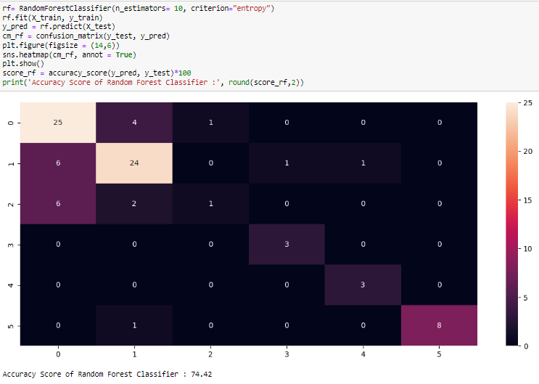
RANDOM FOREST
A glass classifiers model based on random forest can also be used to predict the type of glass based on certain characteristics. Random forest is a type of supervised learning algorithm that can be used for both classification and regression problems, and it works by creating an ensemble of decision trees.
To create a glass classifiers model based on random forest, we would start by gathering a dataset that contains features of different types of glass and their corresponding classifications, similar to the logistic regression model. Then, we would split the dataset into training and testing sets, as before.
To optimize the performance of the model, we can adjust the hyperparameters of the random forest algorithm, such as the number of trees, the maximum depth of each tree, and the minimum number of samples required to

Slide 6
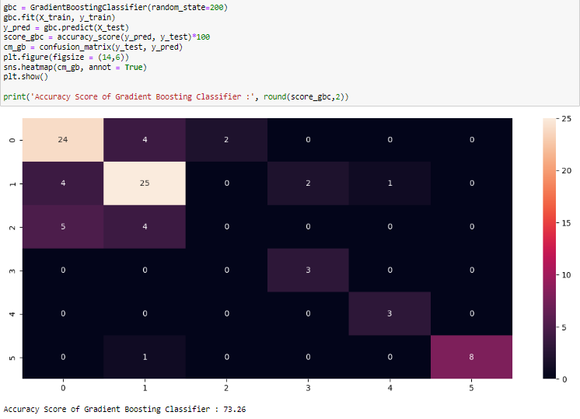
GRADIENT BOOSTING
Gradient boosting is also an ensemble learning method that combines multiple weak models (such as decision trees) to produce a more accurate and robust model.
To build a glass classifier based on gradient boosting, you would first need a dataset of glass samples with known properties, such as their refractive index, sodium, magnesium, and aluminum content, among others. You would then need to split the dataset into training and testing sets to evaluate the model's accuracy.
The algorithm would iteratively create new decision trees that try to correct the errors of the previous trees. Each new tree would focus on the samples that were incorrectly classified by the previous trees, thereby improving the overall accuracy of the model
Overall, a glass classifier based on gradient boosting can be a powerful and accurate way to identify different types of glass based on their chemical and physical properties. However, gradient boosting can be more computationally expensive than other methods, so it may be less practical for large datasets or real-time applications.

Slide 7
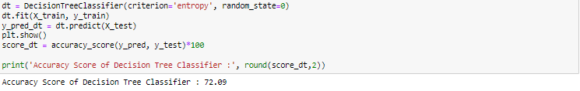
DECISION TREE
Decision trees are simple but powerful models that can represent complex decision-making processes based on a sequence of yes-or-no questions.
a decision tree algorithm to train the model on the training data. The algorithm would iteratively split the data based on the most informative features (e.g., those with the highest information gain) to create a tree of decision rules. Each internal node of the tree would represent a decision based on a feature, and each leaf node would represent a glass type.
Finally, you would evaluate the model's accuracy on the testing set by comparing its predictions with the actual glass types. You could also use techniques like cross-validation to ensure that the model is robust and not overfitting to the training data.

Slide 8
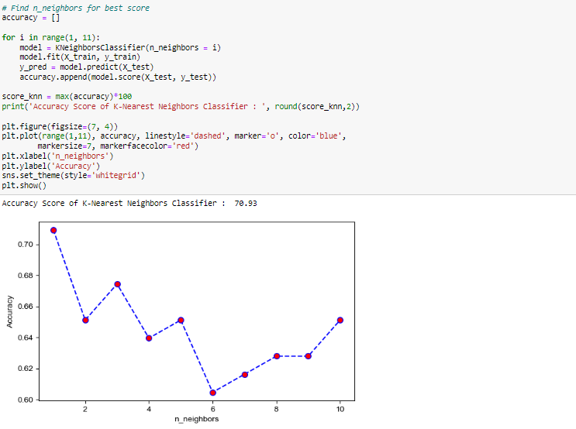
KNN
You would then need to split the dataset into training and testing sets to evaluate the model's accuracy.
Next, you would use the KNN algorithm to train the model on the training data. The algorithm would first calculate the distance between the test sample and each of the training samples based on their features. It would then identify the k-nearest training samples (i.e., the samples with the smallest distances) and assign the test sample to the glass type that is most common among the k-nearest neighbors.
KNN can be sensitive to the choice of k, which can affect both the model's accuracy and its computational efficiency. Therefore, it is important to use techniques like grid search or cross-validation to optimize the choice of k and ensure the best performance of the model.

Slide 9
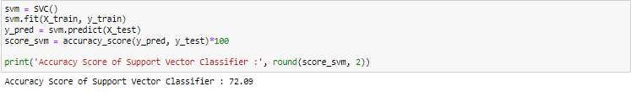
SUPPORT VECTOR CLASSIFIER
use the SVM algorithm to train the model on the training data. The algorithm would try to find a hyperplane in the feature space that can separate the different glass types with the largest margin. In cases where the data is not linearly separable, the algorithm would use a kernel function to map the data into a higher-dimensional space where it can be separated by a hyperplane.
Finally, you would evaluate the model's accuracy on the testing set by comparing its predictions with the actual glass types. You could also use techniques like cross-validation to ensure that the model is robust and not overfitting to the training data.
SVMs can be sensitive to the choice of kernel and the regularization parameter, which can affect both the model's accuracy and its computational efficiency. Therefore, it is important to use techniques like grid search or cross-validation to optimize the choice of hyperparameters and ensure the best performance of the model.

Slide 10
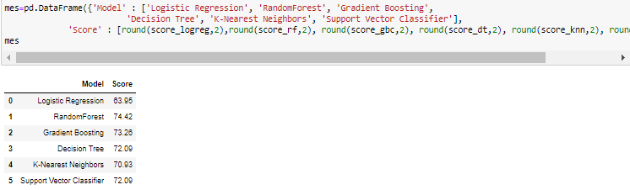
COMPARISON OF MODEL

Slide 11
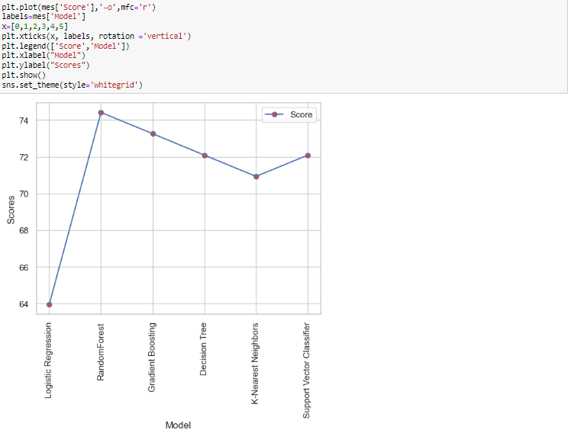

Slide 12
THANK YOU

